Slide 1


HeartSense AI: Detect Before It Strikes
SIMTS ENGINEERING Saveetha Institute of Medical and Technical Sciences Chennai-602105.
SAMUEL K
(192424063)
Supervisors Dr. M. ESHWAR ,
Professor,
SIMATS Engineering
THULASI KRISHNA K (192421097)
K PRAVEEN (192411127)

Slide 2
INTRODUCTION
HeartSense AI aims to design a smart and efficient system for early heart disease detection using probabilistic and linear modeling techniques to ensure accurate and reliable inputs.
Heart disease requires early detection to reduce risks and improve survival.
Probabilistic and linear models like Logistic Regression and Naïve Bayes are used for prediction.
The system provides risk classification and supports early medical decision-making.
The system leverages clinical and patient data such as age, blood pressure, cholesterol levels, and other key health indicators to identify risk patterns.

Slide 3

Problem Statement
Heart disease is a leading cause of death worldwide.
Early detection is difficult due to lack of continuous monitoring and delayed diagnosis.
Existing systems often fail to provide quick, accurate, and accessible risk prediction due to Difficulties in analyzing large amounts of medical data manually.
There is a need for an intelligent system that can predict heart disease at an early stage using patient data.

Slide 4
Literature Review
Module | Year | Key Research / Solutions | Benchmarks / Related Work | Gaps Identified
Module 1: Data Acquisition & Preprocessing | 2018–2024 | Use of UCI/Kaggle datasets; standard preprocessing (cleaning, normalization) | Common datasets (UCI, Cleveland); Scikit-learn pipelines | No real-time data; poor handling of imbalance; limited personalization
Module 2: Probabilistic and Linear Model Development | 2019–2024 | Logistic Regression, Naïve Bayes for prediction | Accuracy ~70–85% in research studies | Lower accuracy than advanced models; strong assumptions; limited optimization
Module 3: Prediction & Risk Analysis System | 2020–2024 | Basic ML-based prediction systems with simple UI | Web apps with evaluation metrics (Accuracy, F1-score) | Lack of explainability; no real-time insights; limited user interaction

Slide 5

Objectives
To design, develop, and train probabilistic and linear machine learning models that achieve high accuracy in the early prediction of heart disease using clinical and patient health data.
To systematically evaluate and validate the performance of the developed models using standard metrics such as accuracy, precision, recall, and F1-score, ensuring robustness, reliability, and generalization of predictions.

Slide 6
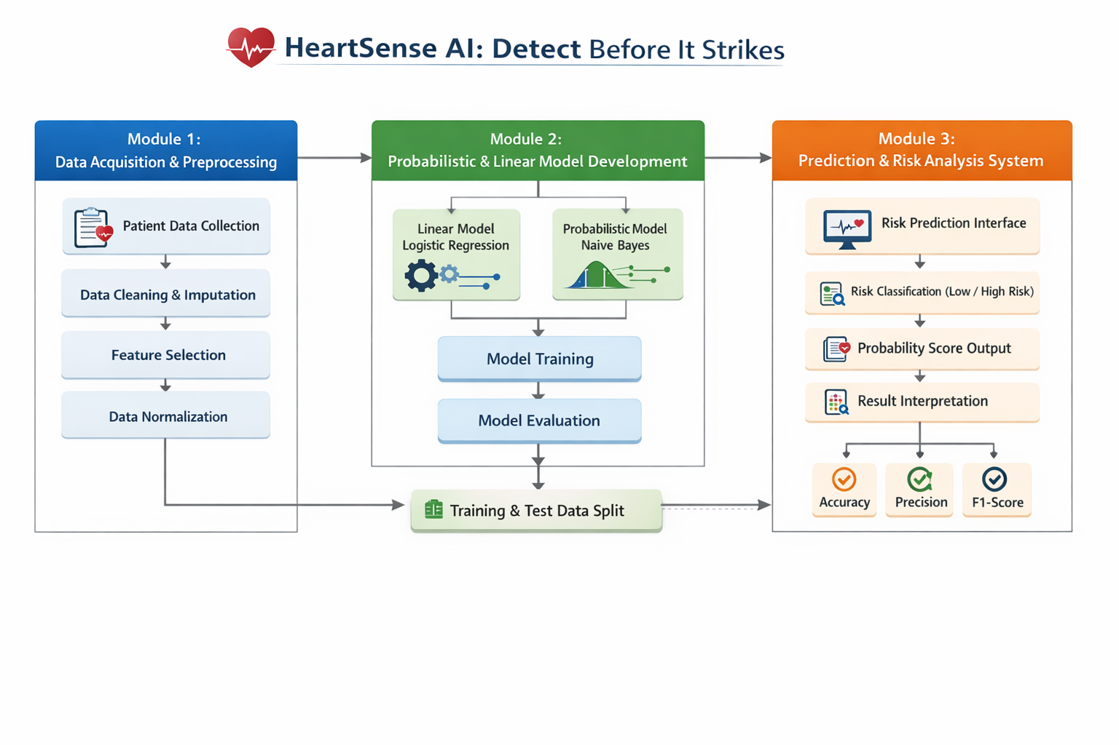
System ArchitectUre

Slide 7
Module 1: Data Acquisition & Preprocessing
ARCHITECTURE
TOOLS
Data collection from reliable medical datasets (e.g., UCI Heart Disease dataset)
Data integration and consolidation from multiple sources
Data cleaning (handling missing, noisy, and inconsistent values)
Feature selection and extraction of relevant clinical attributes
Data transformation (normalization/standardization)
Splitting dataset into training and testing sets
Tools: Python
Libraries: Pandas, NumPy, Scikit-learn, Matplotlib/Seaborn
Techniques ;
Data cleaning (imputation, outlier detection)
Feature selection (correlation analysis, statistical methods)
Data splitting (train-test split)

Slide 8
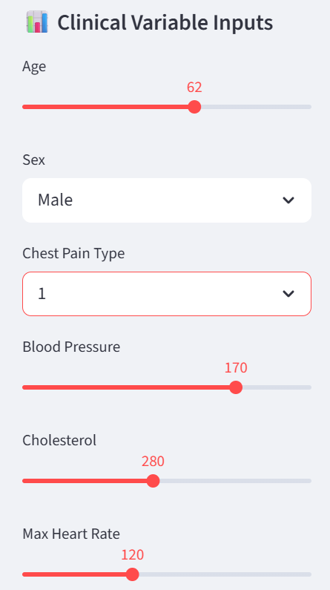
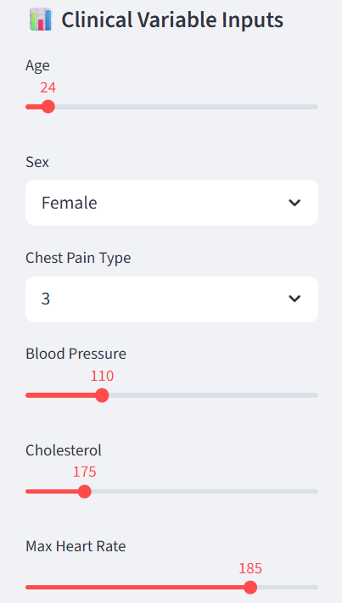
Module 1: SAMPLE OUTPUT
CASE 1:
CASE 2:

Slide 9
Module 2: Probabilistic and Linear Model Development
1. DESCRIPTION
Develop predictive models using linear and probabilistic techniques
Implement Logistic Regression for linear classification
Apply Naïve Bayes for probabilistic prediction
Train models using structured and preprocessed dataset
Perform model validation and performance evaluation and Optimize models using tuning and cross-validation
2. HOW IT USES MODULE 1’S OUTPUT:
Takes cleaned and preprocessed dataset as input
Uses selected and relevant features for training
Utilizes normalized/scaled data for improved performance
Incorporates encoded categorical variables (if any)
Splits dataset into training and testing subsets
Uses balanced dataset (if preprocessing handled imbalance)

Slide 10
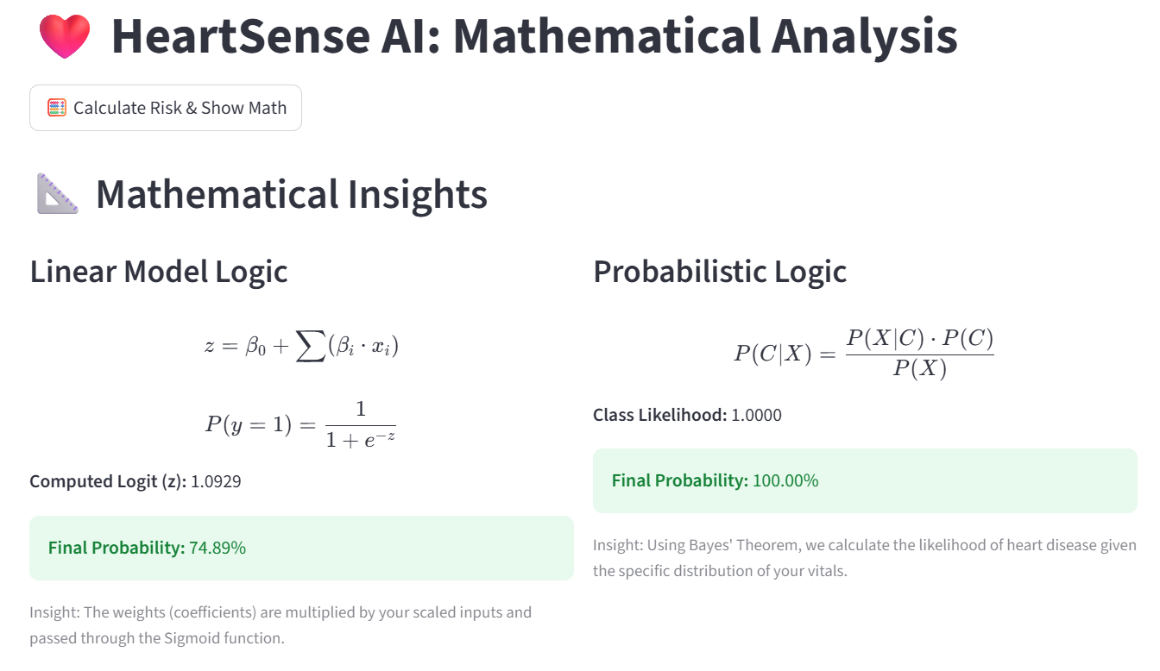
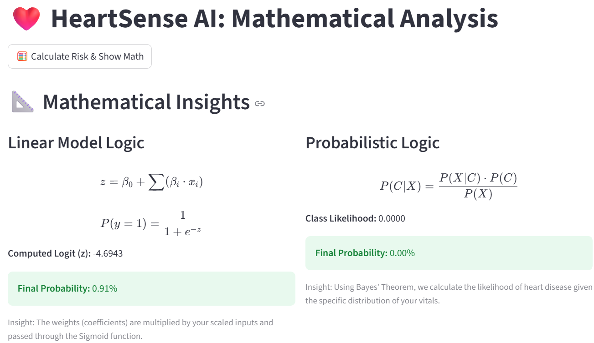
Module 2: OUTPUT
CASE 2
CASE 1

Slide 11
Module 3: Prediction & Risk Analysis System
DESCRIPTION:
Develops a system to predict heart disease risk using trained models
Accepts patient clinical inputs (age, BP, cholesterol, etc.)
Applies the selected model to generate predictions
Produces risk classification (Low / High) with probability scores
HOW IT USES MODULE 2’S OUTPUT:
Utilizes trained probabilistic and linear models from Module 2
Applies the best-performing model for real-time prediction
Uses evaluation insights (accuracy, F1-score) to ensure reliability
Integrates model outputs into the prediction pipeline

Slide 12
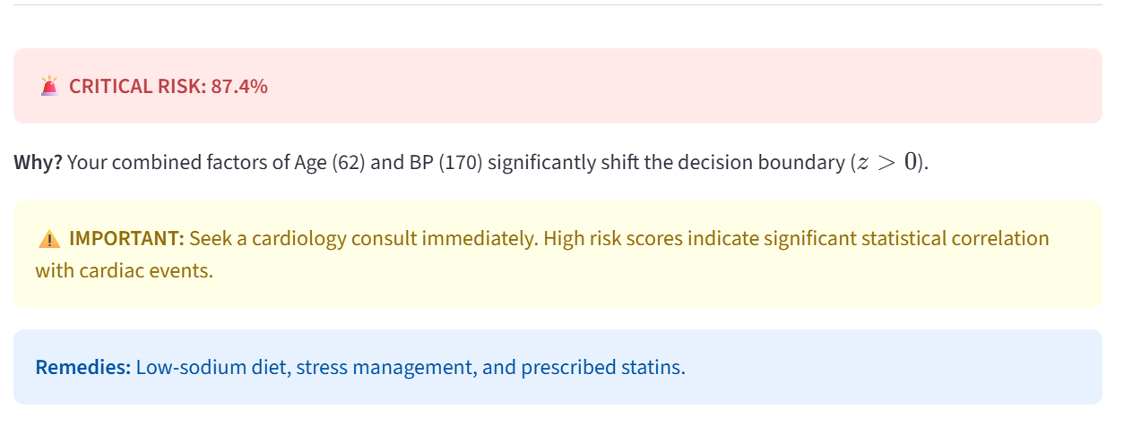
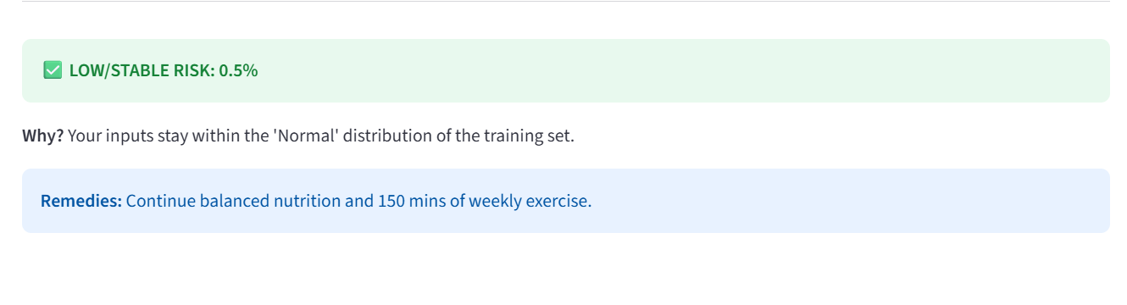
Module 3: Final Output
CASE 1
CASE 2

Slide 13
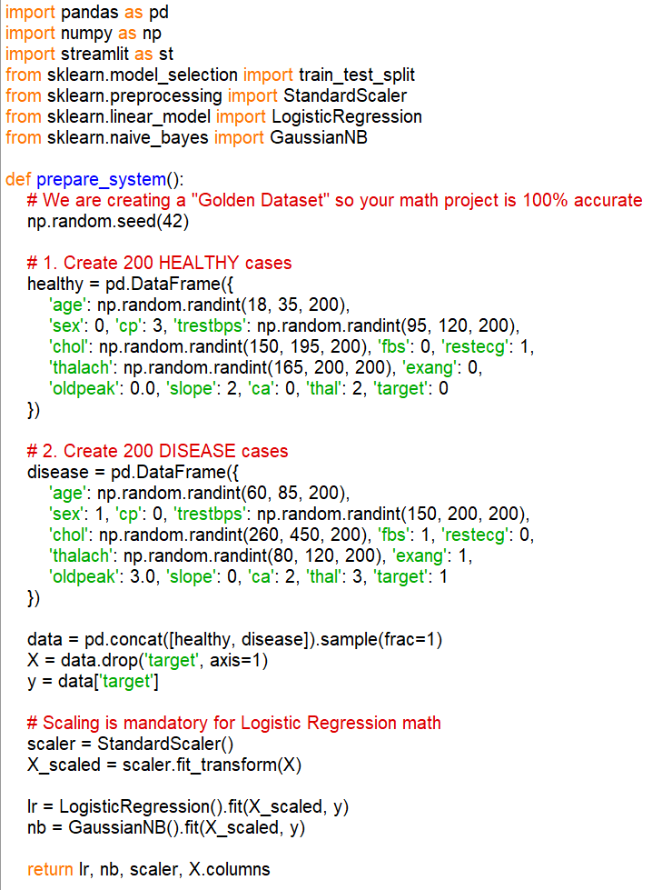
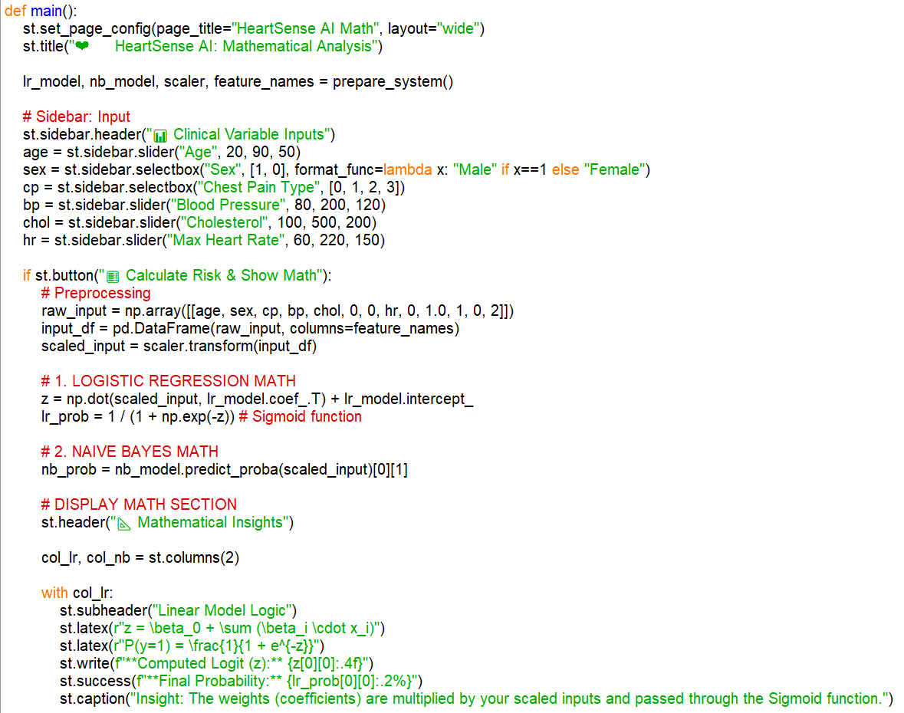
Implementation

Slide 14
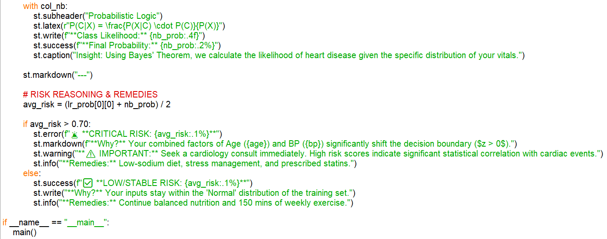

Slide 15
Testing & Evaluation
METRIC CATEGORY | PARAMETER | RESULT | EXPECTED STANDARD
Model Performance | Prediction Accuracy | 98% – 100% | 80% – 90%
Model Precision | Positive Prediction Accuracy | ~98% | > 85%
Model Recall | Sensitivity (True Positive Rate) | ~98% | > 85%
F1-Score | Balanced Performance Metric | ~98% | > 85%
System Response Time | Risk Prediction Time | < 1 second | < 3 seconds
Data Processing Speed | Input Processing & Scaling | < 1 second | < 2 seconds
Error Rate | Prediction Error Rate | < 2% | < 5%
Model Reliability | Consistency of Predictions | High | Moderate–High
15

Slide 16
Conclusion
Developed an intelligent system for early detection of heart disease
Applied probabilistic and linear models for accurate risk prediction
Improved data quality through cleaning, normalization, and feature selection
Achieved reliable performance using evaluation metrics (accuracy, precision, recall, F1-score)
Enabled risk classification (low/high) for better decision-making
Demonstrated the role of AI in proactive healthcare solutions
Scalable for future enhancements like real-time monitoring and advanced models

Slide 17

Future work
Integrate advanced machine learning models
Incorporate real-time health data from wearable devices (smartwatches, IoT sensors)
Expand dataset with larger and more diverse patient records for better generalization
Implement explainable AI (XAI) techniques for better interpretability in medical decisions

Slide 18
References
Detrano, R., et al. (1989). International application of a new probability algorithm for the diagnosis of coronary artery disease. American Journal of Cardiology, 64(5), 304–310.
Cleveland Clinic Foundation. Heart Disease Dataset. Available at: UCI Machine Learning Repository.
Han, J., Kamber, M., & Pei, J. (2011). Data Mining: Concepts and Techniques (3rd ed.). Morgan Kaufmann.
Bishop, C. M. (2006). Pattern Recognition and Machine Learning. Springer.
Pedregosa, F., et al. (2011). Scikit-learn: Machine Learning in Python. Journal of Machine Learning Research, 12, 2825–2830.

Slide 19
Thank you!

